Slide 1
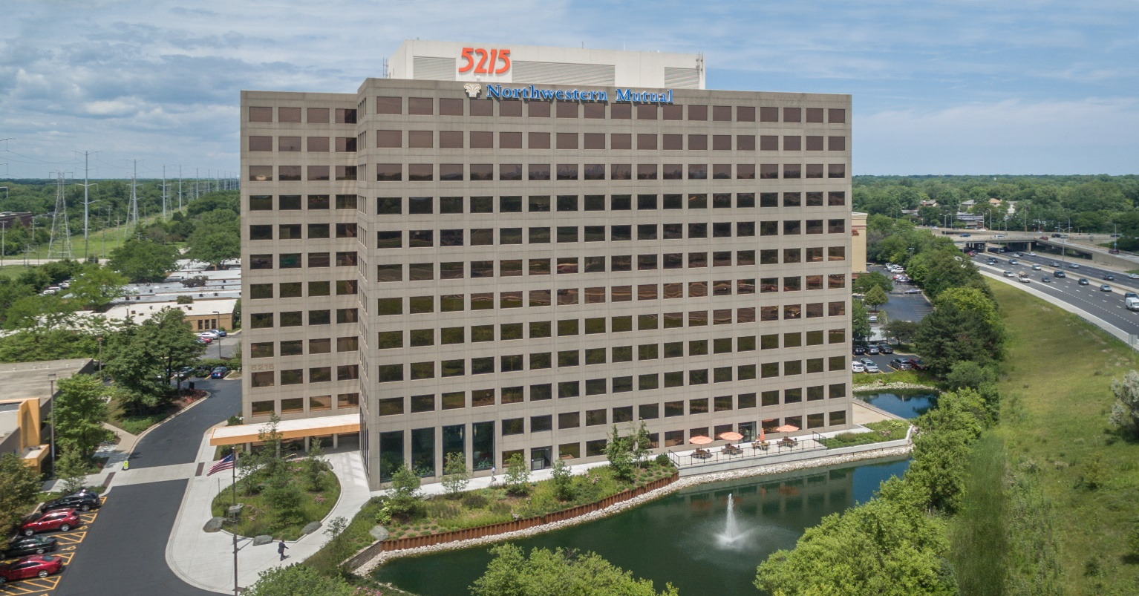
5215 Fire Warden Training

Slide 2
Fire Warden Training Topics:
Importance of Fire Safety Training
Building Safety Features
Duties and Responsibilities
Evacuation Procedures
Handicap Evacuation
Post-Evacuation and Re-Entry
Equipment/Vests
Phone Numbers

Slide 3
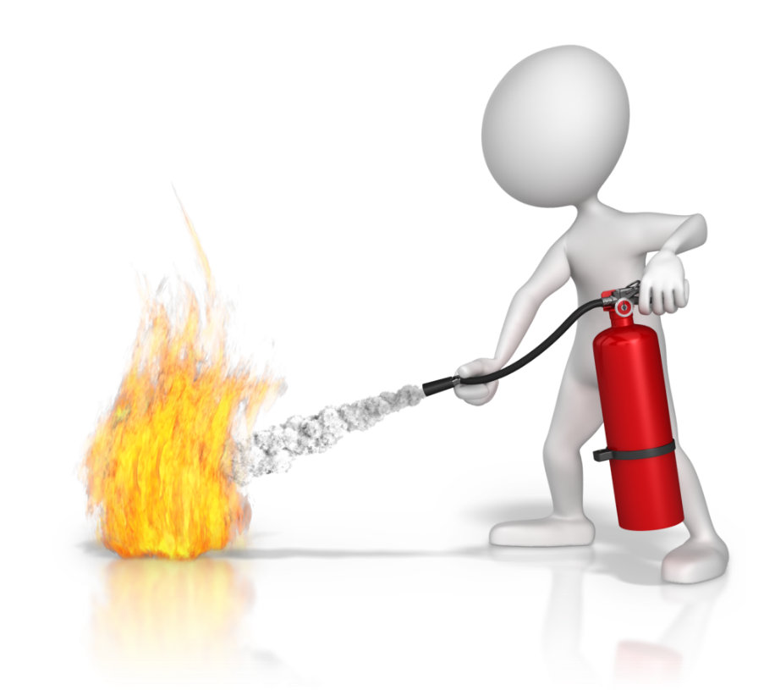
Importance of Fire Safety Training
In the event of an emergency, the most important goal is to keep all employees calm to assist in an organized and successful evacuation of the building.
To do so, we need leaders who are prepared and knowledgeable on the evacuation procedures and safety features of the building.

Slide 4
Building safety Features
Automatic fire sprinklers
Activate when exposed to heat (165 degrees)
Activate as required, not all together
Smoke control and detection systems
Ductwork can detect smoke for early fire detection
Stair enclosure with smoke control (2 hrs) – importance of keeping these doors shut
Fire floor smoke removal or exhaust
Fire alarm system (audio and visual)
Activated by sprinklers, pull stations and smoke detectors
The alarm will go off on all floors, regardless of the fire’s location
Alarm system notified Fire Department
Interior finishes and materials
Fire Drill preparedness
Know of all exits in your suite
Remove restrictive footwear and clothing
Feel doors prior to opening

Slide 5
Duties and Responsibilities
The purpose of a Fire Warden is to assist in creating an organized and efficient evacuation in the event of a fire.
Establish a meeting place after evacuation or have a contact to assist with a headcount
Provide information relating to fire conditions if applicable
Inform Fire Department of required rescues if applicable
Large tenants may look to add the following roles:
Searchers
Stair Monitor
Personal Assistants
Communicators
First Aid
Understand and memorize your company’s individual fire evacuation plan, be sure to share this with any new hires and provide at least annually to all employees.

Slide 6
Evacuation Procedures
The Fire Warden should exhibit a concern for others and take an assertive attitude to lead their company safely out of the building.
In the event of a fire, all employees should stop what they are doing and head towards the nearest exit
An evacuation plan should be in place for your office, defining the fastest route to the nearest stairwell
5215 Old Orchard Road contains two stairwells, one on the west side and one on the east side of the building. Take a minute one day to locate these entrances and the proximity to the exits of your suite.
Employees should remove high-heels or any restrictive items when evacuating
Remind employees to stay on the LEFT side of the staircase so those in the handicap assistance area do not get trampled and the Fire Department can access them on their way up the stairs.
Do NOT take the elevators during an evacuation

Slide 7
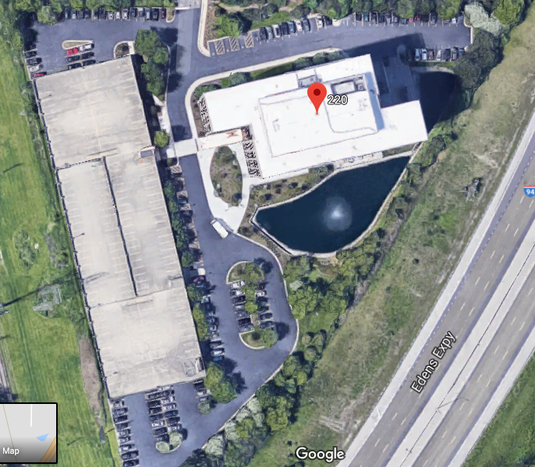
Everyone should evacuate to the yellow zones on the map. Notice: these evacuation areas are clear of the entrance road.
The building has 5 exits on the first floor, marked with the blue stars.

Slide 8
Handicap evacuation
Those with disabilities should wait for assistance on the stairway platform, tucked in the corner towards the wall. The stairwells are fire proof for two hours and protect these individuals until help comes.
The Fire Department will search all stairways to rescue these individuals.

Slide 9
Post-Evacuation
If you know of any handicap or trapped employees waiting for assistance, make this known to the Fire Department.
Fire Wardens should direct employees as far away from the building
This helps to keep room for others who are evacuating and stay clear of emergency vehicles coming down the driveway
Take a head-count of your employees. If your office is large enough where employees utilize multiple exits, include a roll-call method as part of your office’s emergency plan
Employees should wait outside until notice is given by the Fire Department or Management office that it is safe to re-enter the building

Slide 10
Phone Numbers
Please save these phone numbers in the event of an emergency:
Building Management: 847-423-2300 (24/7)
Building Engineer: 847-423-4202 (Mon-Friday 7am – 3pm)
Skokie Fire Department Non-Emergency: 847-982-5320
Skokie Police Department, Non-Emergency: 847-982-5900
Skokie Hospital: 847-677-9600 / Emergency Room: 847-933-6950
Fire Department: 911

Slide 11
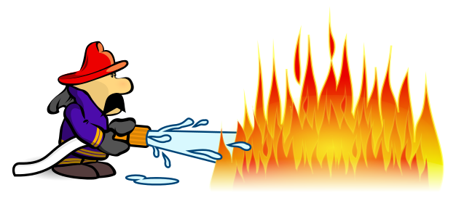
Questions?

